Slide 1
InvocMap Overview

Slide 2
Overview
Implementing correct method invocation is an important task for software developers. However, this is challenging work, since the structure of method invocation can be complicated. In this paper, we propose InvocMap, a code completion tool allows developers to obtain an implementation of multiple method invocations from a list of method names inside code context. InvocMap is able to predict the nested method invocations which their names didn’t appear in the list of input method names given by developers. To achieve this, we analyze the Method Invocations by four levels of abstraction. We build a Machine Translation engine to learn the mapping from the first level to the third level of abstraction of multiple method invocations, which only requires developers to manually add local variables from generated expression to get the final code. We evaluate our proposed approach on six popular libraries: JDK, Android, GWT, Joda-Time, Hibernate, and Xstream. With the training corpus of 2.86 million method invocations extracted from 1000 Java Github projects and the testing corpus extracted from 120 online forums code snippets, InvocMap achieves the accuracy rate up to 84 in F1- score depending on how much information of context provided along with method names, which outperforms the state-of-the-art Neural Machine Translation approach by 40% and shows its potential for auto code completion.

Slide 3
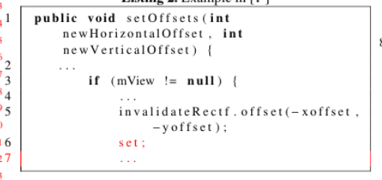
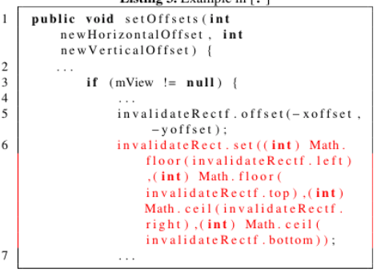
Input and Output
Input Output
InvocMap
Notes:
In this work, we provide an intelligent code editor which is able to suggest useful information for developer while doing coding.
There are several functions we developed. In this project, we provide an utility function which helps developers to get the method invocation (in the form of complex AST which can contain multiple nested method invocation.
Given the output of InvocMap, developer only needs to add local variables/ literals to the AST to get the final implementation.

Slide 4
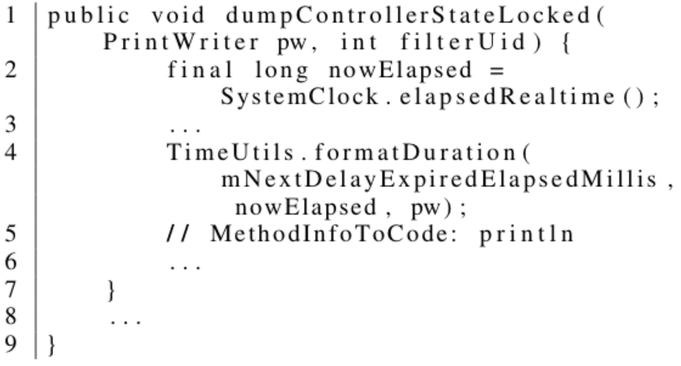
Input and Output (2)
Input: println
E-Total-000007754
#.println()
java.io.PrintWriter
java.io.PrintWriter
java.io.PrintWriter#println#()
Notes:
InvocMap is able to predict the MI with 2 advantages compared to prior MI suggestion works:
Prediction with context information.
The result of “print” is a MI of java.io.PrintWriter, instead of the most popular MI System.out.println, since the context shows that it was developed in Android environment
Prediction available for multiple method names at the same time
Previous work can only predict one MI for each excecution.

Slide 5
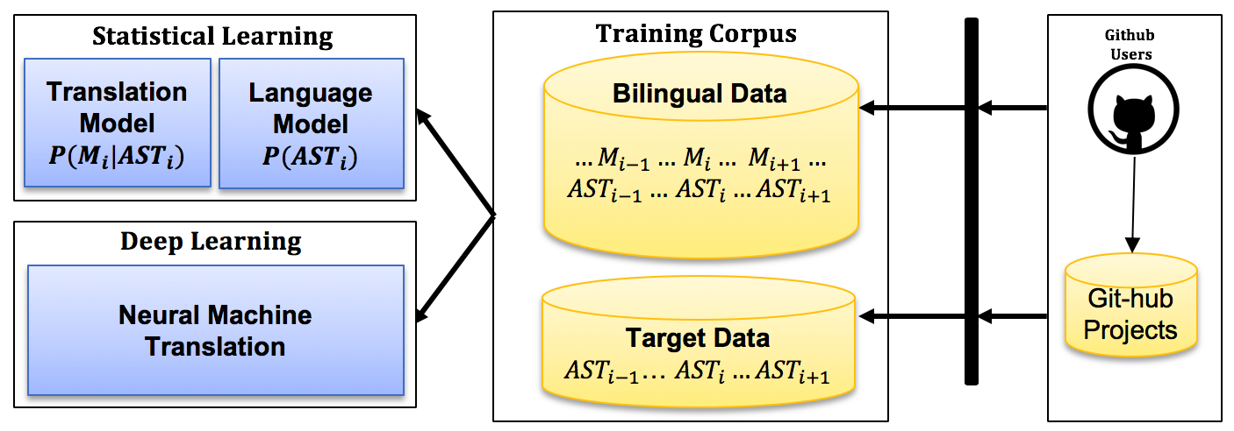
InvocMap
Notes:
We consider the code environment as 2 spaces:
Source: method names and other code tokens.
Target: method invocations and other code tokens.
We learn the mapping from spaces of method names to method invocation by Machine Translation:
Statistical Machine Translation.
Neural Machine Translation.
The training is built from the space of 1000 high quality Github Java projects.

Slide 6
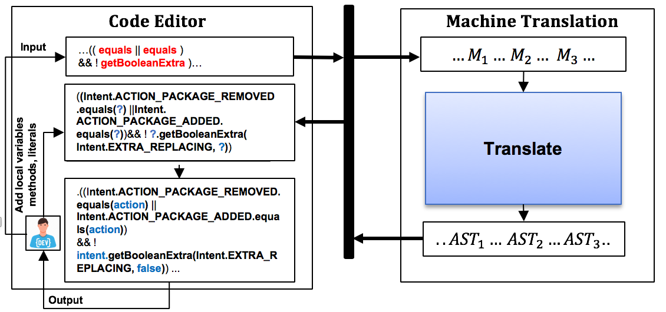
InvocMap (2)
Notes:
The application is the code editor. We do the evaluation one suggesting method names for 120 posts of Stackoverflow Code Snippet.

Slide 7
Evaluation: Accuracy of InvocMap by SMT
 | Extrinsic Evaluation with Configuration 3
Library | Correct | Incorrect | OOSource | OOTarget | OOVoc | Total | Precision | Recall | F1-Score
GWT | 89 | 4 | 0 | 9 | 9 | 102 | 95.70% | 90.82% | 93.19%
Joda-Time | 55 | 3 | 2 | 15 | 17 | 75 | 94.83% | 76.39% | 84.62%
JDK | 174 | 32 | 0 | 44 | 44 | 250 | 84.47% | 79.82% | 82.08%
Android | 82 | 11 | 0 | 13 | 13 | 106 | 88.17% | 86.32% | 87.23%
Hibernate | 146 | 40 | 1 | 39 | 40 | 226 | 78.49% | 78.49% | 78.49%
Xstream | 50 | 0 | 0 | 14 | 14 | 64 | 100.00% | 78.13% | 87.72%
Total | 596 | 90 | 3 | 134 | 137 | 823 | 86.88% | 81.31% | 84.00%
Notes:
The accuracy can be up to 86.88% depends on how informative the context provided from the developer
Configuration means the level of useful information developers give along with the method name. We allow developers to input some local variables. literals and some words they remembered about the MI for better suggestion.

Slide 8
Evaluation (2): Comparison between SMT and NMT
Configuration | Statistical Machine Translation |  |  | Neural Machine Translation
Intrinsic | Precision | Recall | F1-Score | Precision | Recall | F1-Score
Configuration 1 | 70.43% | 75.89% | 73.06% | 54.09% | 46.18% | 49.82%
Configuration 2 | 84.04% | 78.98% | 81.43% | 46.77% | 67.97% | 55.41%
Configuration 3 | 89.33% | 79.98% | 84.40% | 49.27% | 69.09% | 57.52%
Extrinsic | Precision | Recall | F1-Score | Precision | Recall | F1-Score
Configuration 1 | 62.54% | 75.80% | 68.53% | 44.62% | 49.71% | 47.03%
Configuration 2 | 86.01% | 81.16% | 83.51% | 33.38% | 62.57% | 43.54%
Configuration 3 | 86.88% | 81.31% | 84.00% | 34.84% | 63.56% | 45.01%
Notes:
Surprisingly, we see that for this problem the SMT outperforms the NMT. However, several prior works in NL and SE in translation have the same winner as SMT over NMT. The possible reason is due to the characteristic of this research problem:
Parallel corpus doesn’t require to reordering.
Parallel corpus has the same length between source and target.
The NMT provides better translation speed compared to SMT, which provides potential to improve the NMT to have the best Machine Translation technique.

Slide 9
Thank you

Slide 10
Appendix: Resolve multiple method names
Prior work: AnyCode [1]
Handle sequentially
Output 1: SystemClock.elapsedRealTime()
Input 1: elapse real time
Output 2:
pw.println(“message”)
Input 2: println

Slide 11
Appendix: Resolve multiple method names
InvocMap
Handle concurrently
Output 1: SystemClock.elapsedRealTime()
Input 1: elapse real time
Output 2:
pw.println(“message”)
Input 2: println

Slide 12
References
AnyCode. https://lara.epfl.ch/~kuncak/papers/GveroKuncak15SynthesizingJavaExpressionsFreeFormQueries.pdf
Notes:
InvocMap is able to predict the MI with 2 advantages compared to prior MI suggestion works:
Prediction with context information.
The result of “print” is a MI of java.io.PrintWriter, instead of the most popular MI System.out.println, since the context shows that it was developed in Android environment
Prediction available for multiple method names at the same time
Previous work can only predict one MI for each excecution.

